Slide 1
Recommendation system based on customer reviews
Team united
Members:
Mani shankar reddy nayakanti
Beeneedi Harshith
Uday sai krishna Yarlagadda
Sai krishna jammigumpula

Slide 2
Introduction
Our Project is based on Recommendation system based on the customer reviews .
Language used is Python and it is a web application that used Django Framework.
Our Application asks user to search for the product and display the best product with best review and rating.
This project asks user to login/Register to the application with the credentials and these credentials are stored in a sql database.

Slide 3


Problem Statement
Customers now a days are spending hours to find the best product available in the segment they are willing to buy.
Due to poor browsing experience provided by e commerce website people are prone to buy false products.
They require a system that would help them to recommend the best product based on the customer ratings of the products which were given previously.

Slide 4

Solution
Recommendation system based on customer reviews is developed
It is a Deep Learning Model which recommends customer the best product available based on the product revies and ratings.
Customer can benefit from spending too much time for searching the product.

Slide 5
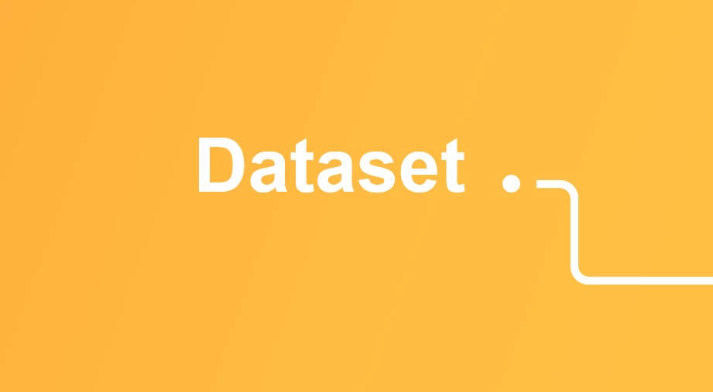
Dataset used
Amazon reviews for sentiment analysis.
Dataset contains two columns reviews and ratings
Rating 0 corresponds to 1- and 2-star reviews, and Rating 1 corresponds to 4- and 5-star reviews.

Slide 6
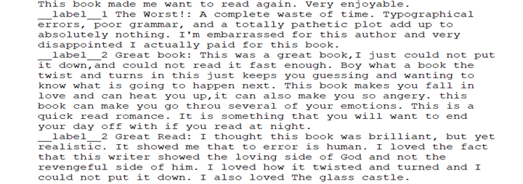
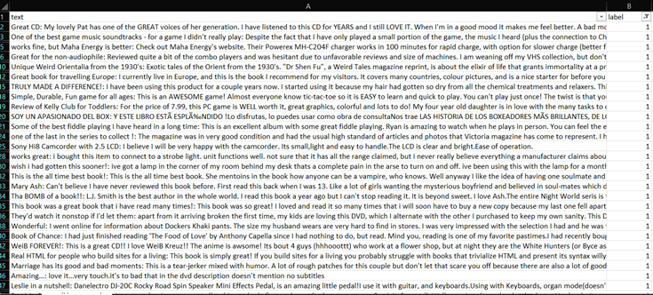
Pre Processing
First step is to change the raw data to columns format.
One column having reviews and another column having ratings
Coded Label 1 as 0 and Label 2 as 1 for our convenience and have placed two columns. Named text and label.
We have ignored languages other than English by using stop words.
Converting all upper-case letters to lower- case letters.

Slide 7
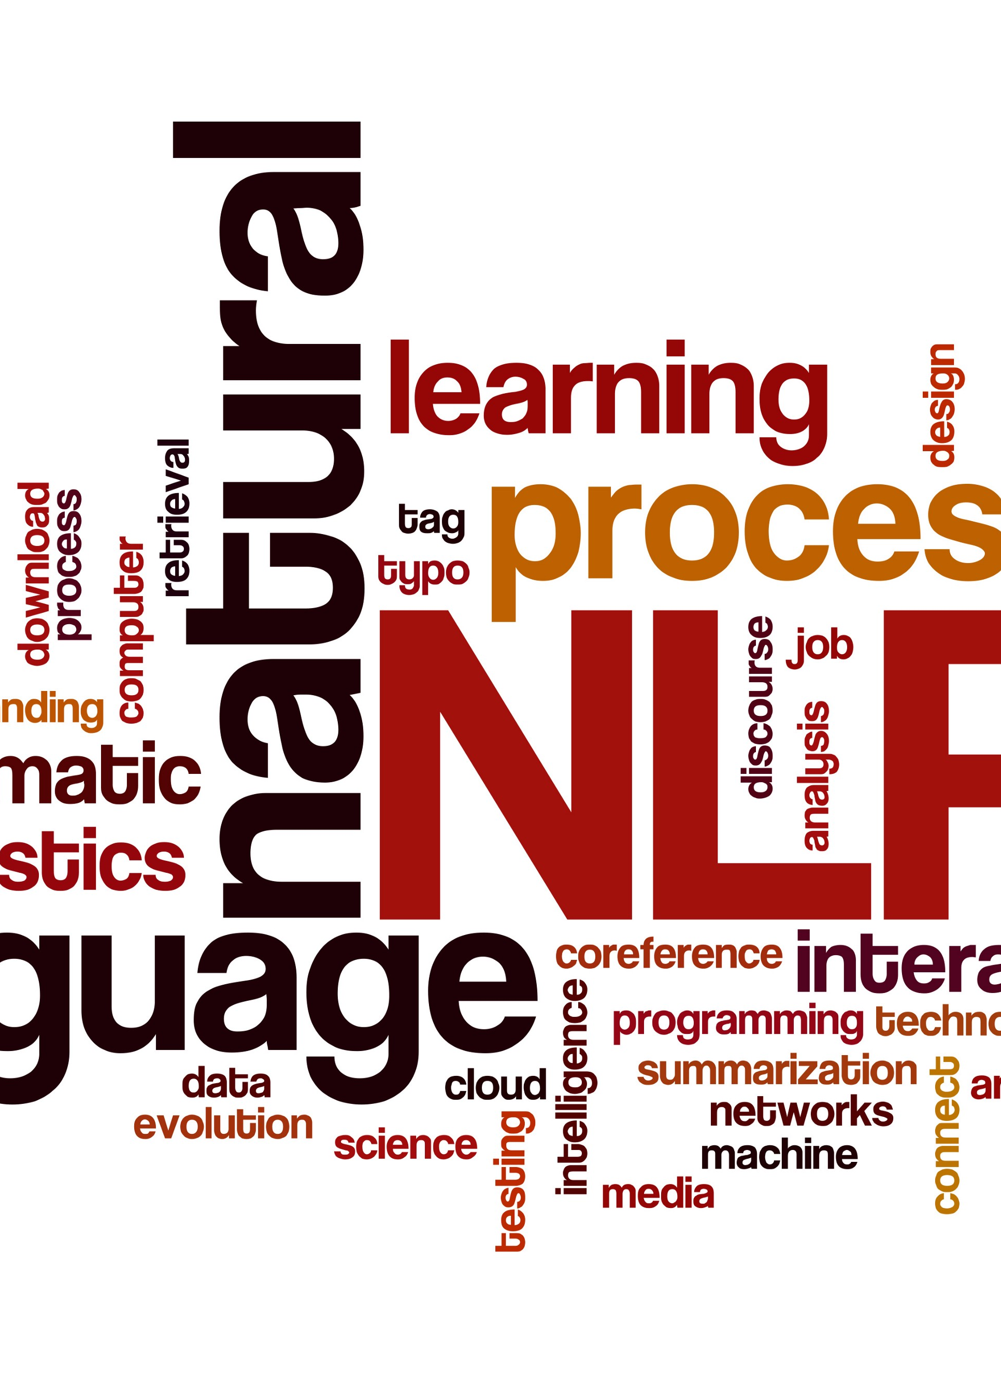
Model
NLTK already has a built-in, pretrained sentiment analyzer called VADER.
For processing the data and finding the insights of the data we have used Sentiment intensity Analyzer model.
Model is sentiment based analyzer we have to find positive, negative scores based on the sentiment using polarity scores
Assigned the score greater than 0.05 as positive and less than that score as negative

Slide 8
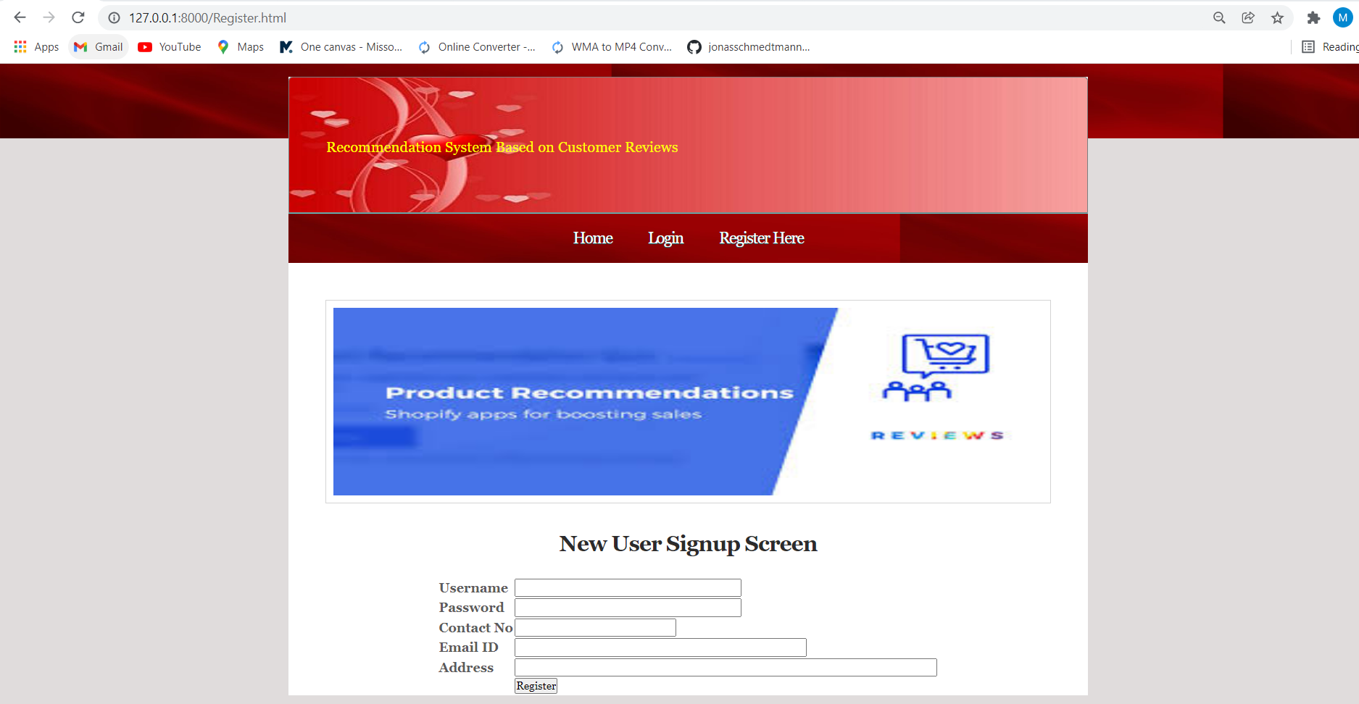
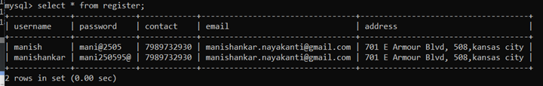
APPLICATION
The application we have created is a web application using Django framework and have used my sql database to store the login credentials given by user during registration process.
The user data is captured and stored in the table

Slide 9
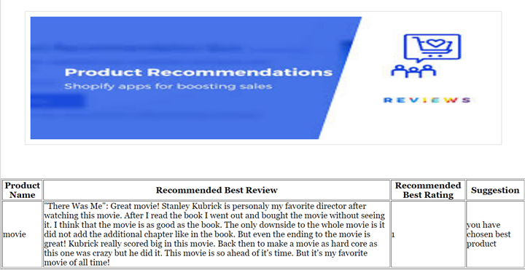
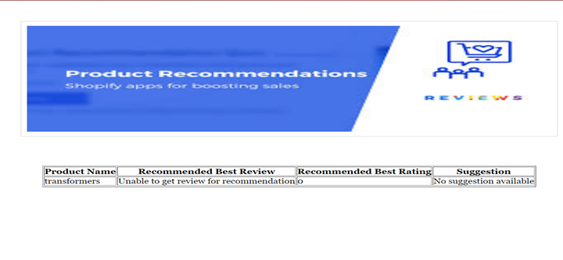
OUTPUT
User need to login/Register using his credentials
User needs to enter product name of his choice.
The product is found in the data set it will give the best recommendation with best rating and suggestion.
Product not found in the dataset will notify as unable to get review.

Slide 10






Slide 11
References
https://www.kaggle.com/bittlingmayer/amazonreviews
https://realpython.com/python-nltk-sentiment-analysis/
https://www.fullstackpython.com/django.html
https://www.digitalocean.com/community/tutorials/build-your-first-python-and-django-application
https://medium.com/coders-camp/60-python-projects-with-source-code-919cd8a6e512

